Slide 1
Programming Merit badge
© 2022 Benjamin Davis

Slide 2
Before we Start: Who am i?

Slide 3
What is programming?

Slide 4
What is programming?
How do we tell a computer what to do?
Instructions?
Language?
A step-by-step recipe

Slide 5
What Are We learning?
How did programming come to be?
What is a programming language? And what are some examples?
Why do we program?
What is intellectual property?
How do we program?
How do we make a living programming?

Slide 6
Safety First!

Slide 7
Safe Programming
Computers are powerful machines.
Make sure the computer is in good working order and the cables aren’t damaged
Keep liquids away from the computer
Looking for help
Even the best programmers use the internet to look for help
Cyber-chip and common sense

Slide 8
Safe Programming
Repetitive Strain Injuries
Lots of typing or repetitive motions can place strain on joints
Like tennis elbow, but from programming
How do we prevent it?
Take breaks
Stretch
Eye Strain
Long term focus and staring at a computer monitor can cause headaches and other issues
How do we mitigate the effects?
Take breaks

Slide 9
A Brief History of computers

Slide 10
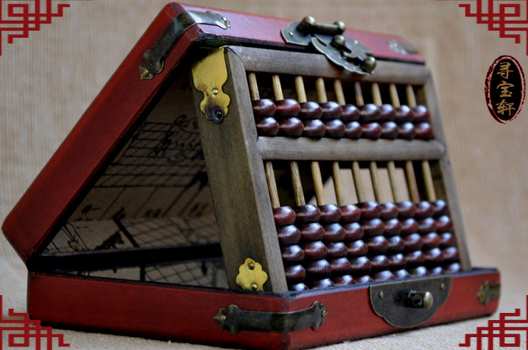
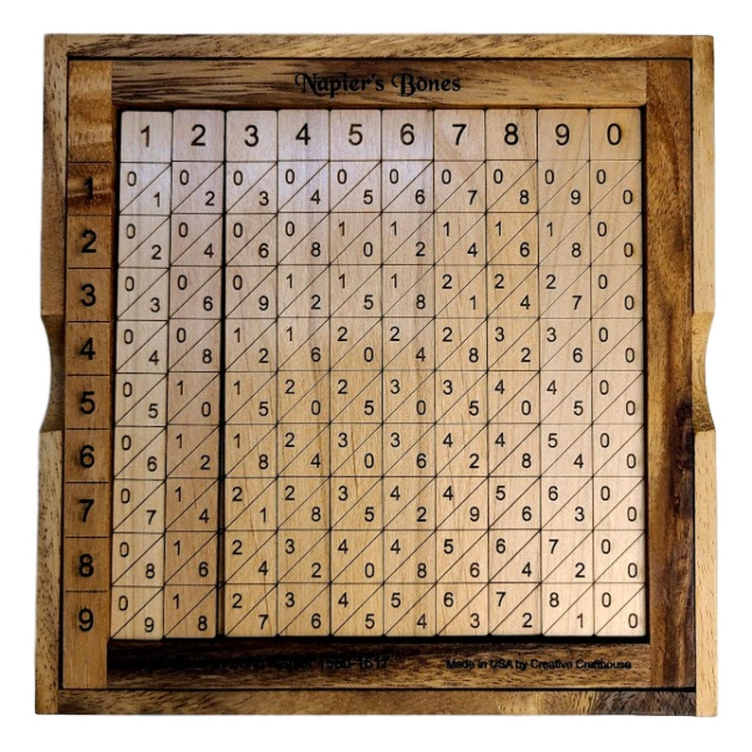
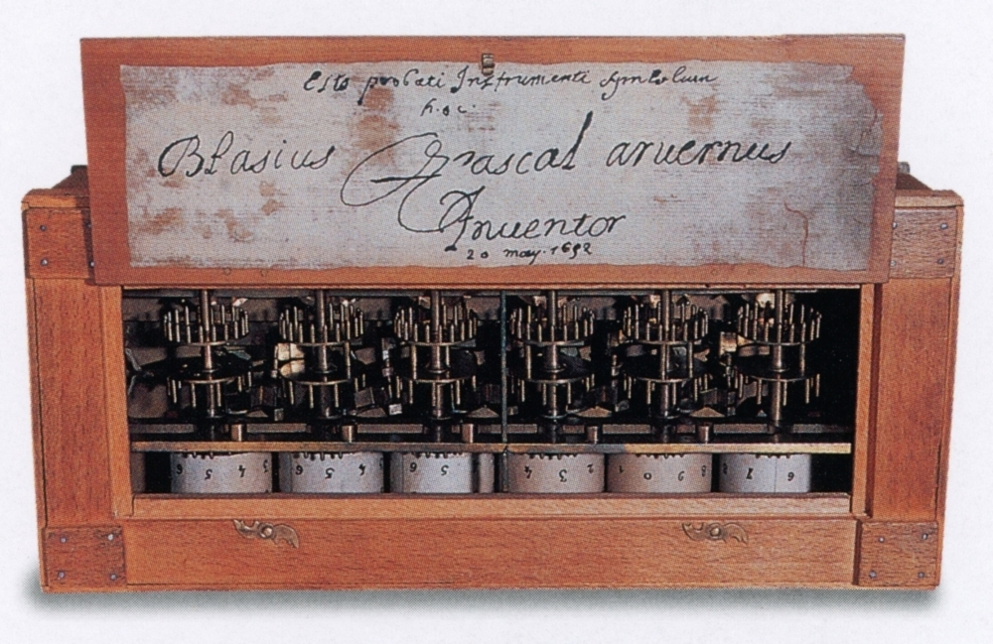
Earliest Computers
Abacus
Napier’s Bones
Pascaline

Slide 11
An origin of Terms
Where do we get the term “Computer”?
In the early 20th century people (mostly women) performed complex calculations by hand
They were called computers
When these calculations could be done via electronics the term followed

Slide 12
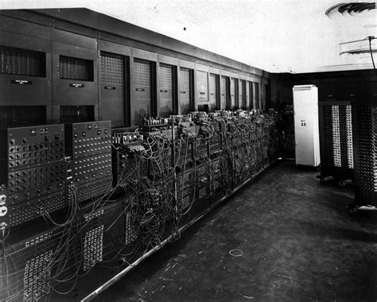
First Electronic computers
Room sized
Vacuum tubes, cables, and punch cards
First identifiable machine language
Electronic Numerical Integrator and Computer (ENIAC)

Slide 13
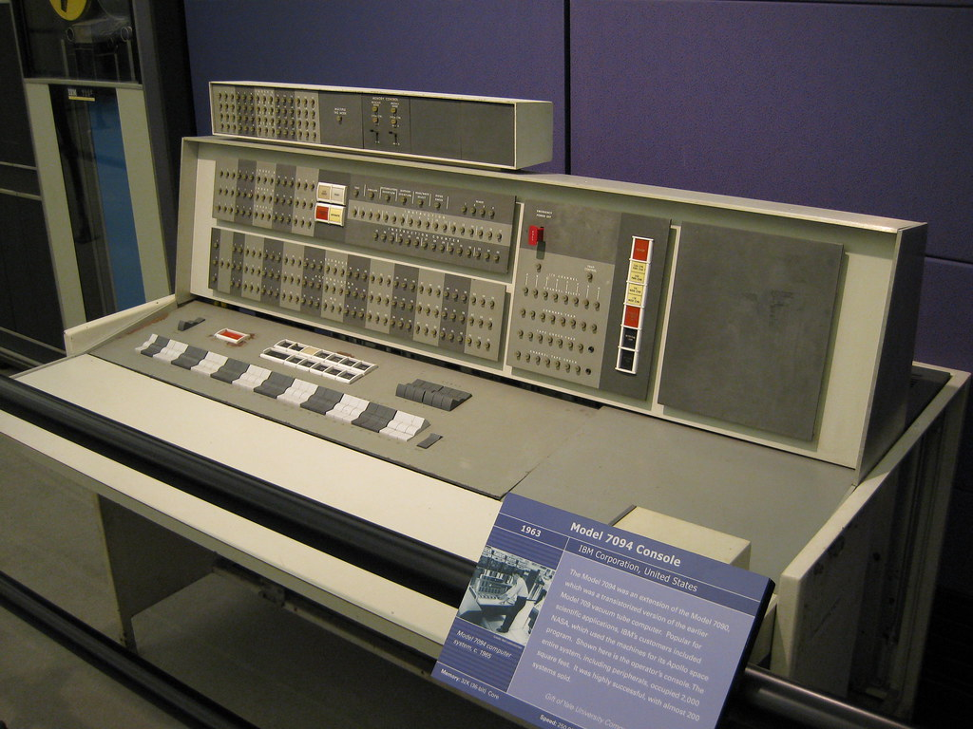
First Transistor computers (Late 50’s)
Used transistors rather than vacuum tubes
Punch cards
First identifiable programming languages
IBM 1620, IBM 7094, CDC 1604, CDC 3600

Slide 14
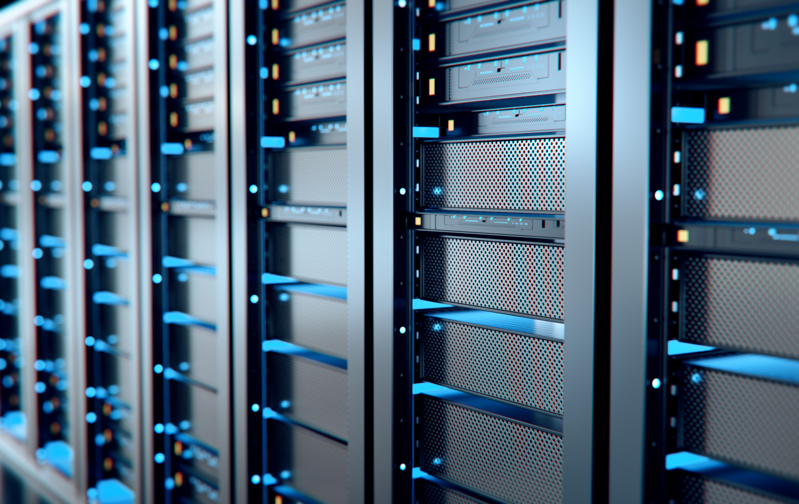
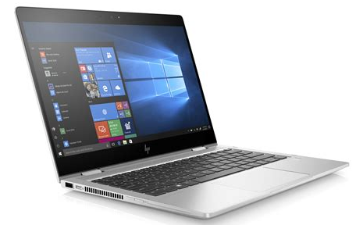
Modern Computers
Multiple Core Processors
Dedicated Graphics Processors
Dozens of Programming Languages

Slide 15
A Brief History of Programming

Slide 16
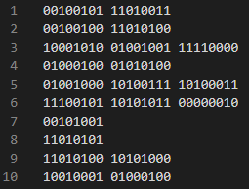
Machine Language – The First Programming Language
Binary (1’s and 0’s)
Hard to Read
Perfectly Fast
Every Other Language Ends Up Here
Different per CPU

Slide 17
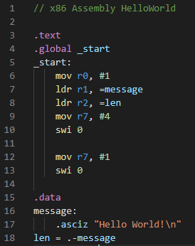
Assembly Language – Human Readable ML
Directly Translates to ML
Human Readable
Still Perfectly Fast After Assembly
Not Quick to Write

Slide 18
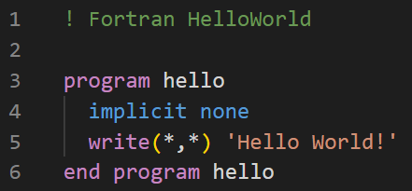
First Portable Languages
Procedural-Languages
Easier to Read and Write
Same Code Can be Used Between CPUs
Need Compilation to Machine Language
Several Major Languages Still In Use:
Fortran, LISP, BASIC, C

Slide 19
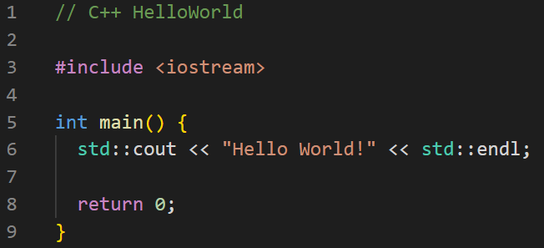
Object Oriented Languages
New Programming Paradigm
Easier to Represent Real World
Objects Contain Descriptive Properties
Some Examples in Use:
C++, Java, Python

Slide 20
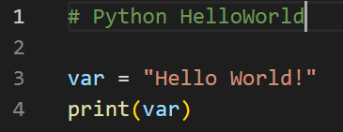
Functional Languages
Use a Series of Math-like Functions to Derive the Answer
Easier to Solve Complex Problems and Read
Modern Examples:
Python, C#, Clojure

Slide 21
Specialized Languages – Logic Languages
Describe the Result not the Process
Start with a List of True Statements, Derive the Result to the Question
Can be Useful for Solving Problems w/ No Known Path to Solution
Often not as Fast
Modern Examples:
Python, C#, Clojure

Slide 22
Specialized Languages – Hardware Description Languages
Describe Hardware, Not Software
Need Specialized Hardware to Run
Extremely Fast (Faster than ML)
Modern Examples:
SystemVerilog, SystemC, VHDL

Slide 23
Specialized Languages – Database Languages
Designed to Get Information from Large Databases
Limited in Scope
Modern Examples:
SQL and it’s derivatives

Slide 24
Where is Programming Used Today?

Slide 25
What Devices Are Programmed?
How Many Devices in this Room Are Programmed?
I bet there is more than you think.

Slide 26
What Are Some Things Programs Do?
Internet
PHP, HTML, CSS, JavaScript, SQL
Operating Systems
C, C++, Go
Automation
Python, Ladder-Logic, Bash
Math/Data Analysis
Matlab, R, Fortran, C++
Video Games
C++, C#, Java

Slide 27
What Are Some Things Programs Do?
User Programs (Think Apps or Microsoft Office)
C#, Go, Swift, ObjectiveC, Java, Kotlin,
Shopping and Banking
SQL, JavaScript, C++, Ruby
Security
Rust, Python, C, et. Al
Automated Intelligence
Python, Prolog, C++, Clojure, LISP
Embedded Systems
C, RUST, ASM

Slide 28
Before We Program – Understand Intellectual Property in the Coding Space

Slide 29
What is Intellectual Property?
Protections Provided to People Who Create New Stuff
Can be Books, Code, Designs, or even Plants!
4-Types
Copyright
Patent
Trademark
Trade Secret

Slide 30
What is CopyRight?
Protects the Expression of an Idea
Examples
Images, Game Art, Specific Code
How long?
Life of Author + 70 years
95-120 years for a Company

Slide 31
What is a Patent?
Protects Innovative Process, Method, Machine, Manufacturable Items, or “Compositions of Matter”
Examples
One-click button, New Graphics Algorithms
How long?
17-20 years, but is not automatic

Slide 32
What is a Trademark?
Protects Words, Phrases, Symbols, Sounds, or Even Colors which Identify the Source of a Particular Product or Service
Examples
Logo, Catch-Phrase
How long?
The Duration of the Identifiable Entity

Slide 33
What is a TradeSECRET?
Protects Valuable Information which Cannot be Legally Shared
Does NOT Protect Against Secondary Discovery
Examples
TikTok’s Algorithm, Coca-Cola’s Recipe
How long?
As Long as the Secret can be Maintained w/o Secondary Discovery

Slide 34
Owning vs Licensing
Do I own a copy of TikTok?
Do I own a copy of the Video Game I am playing?
Do I own the App I build?
What’s the Difference between Owning and Licensing?
Owning means you control the software and can do whatever you’d like with it.
Often implies ownership or license of any other IP
Licensing means you have permission to use the software in some specified way

Slide 35
All Licenses are Not Equal
All Rights Reserved
Commercial Use License
Open-Source
Freeware
Shareware
https://choosealicense.com/
Public Domain

Slide 36
Some Homework…
Research 3 Interesting Career fields in programing and come ready to discuss what you’ve learned

Slide 37
How do we program?

Slide 38
First Steps
Decide what you want to do
Check that you aren’t using someone else’s IP without permission
Install the tools
Programming Language
IDE
Virtual Machine

Slide 39
Getting Started Programming
Determine the Inputs/Outputs
How are these related to each other?
Come up with a program flow
What needs to happen in what order?
Decompose the flow
Break the program flow into manageable chunks (no one sits down and writes a 1000 lines of code in a day)

Slide 40
Getting Started Programming
Get Started Coding
Code chunk by chunk
Test your code as much as possible as you go
Learn from mistakes, but don’t overwrite working code because “it could be better”

